Slide 1


Lesson 1
Back to school
UNIT 1

Slide 2

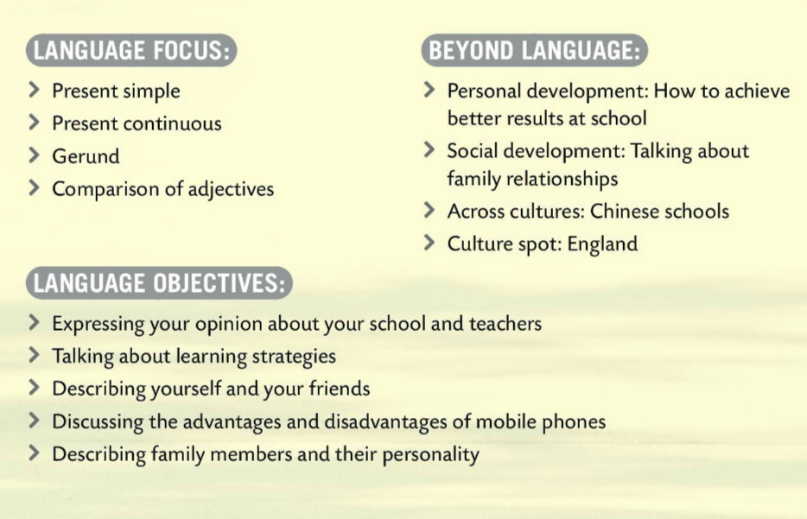
BACK TO SCHOOL
IN THIS UNIT YOU WILL LEARN…

Slide 3

How did you spend your summer holidays?
Write a short essay on how you spent your summer holidays.
Here are a few tips to consider before writing.
Make a list of things you’ve done over the summer.
Narrow it down! Write about your most memorable moment.
Organize your ideas – create an outline. Put them in order of how you're going to write about them.
Focus on your feelings - use all your senses to describe experiences.
Have fun! ☺

Slide 4
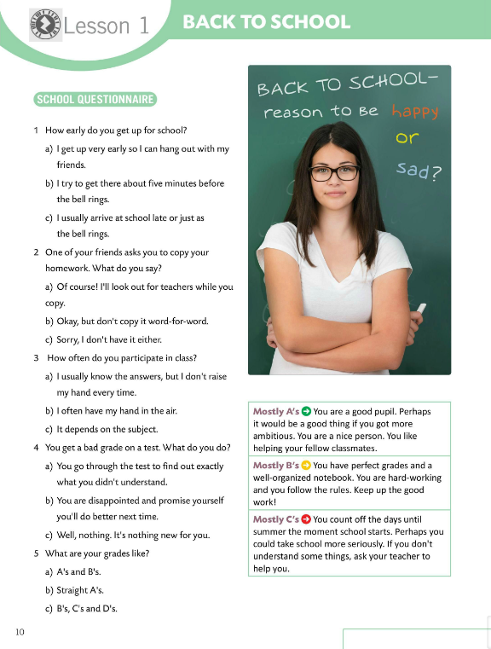
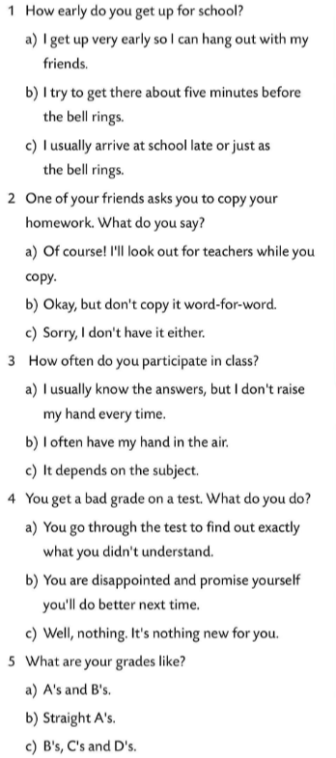
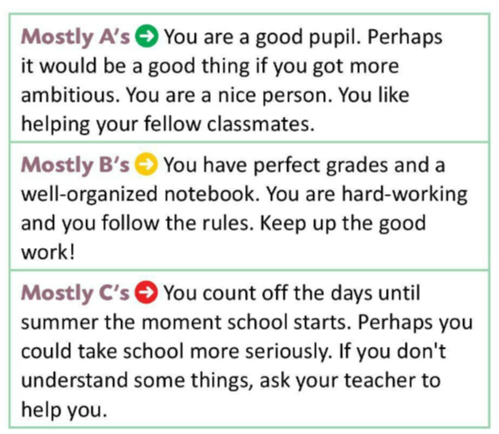

Solve the school questionnaire.
Check if you have answered mostly A’s, mostly B’s or mostly C’s.
Then, find out what kind of pupil you are.

Slide 5
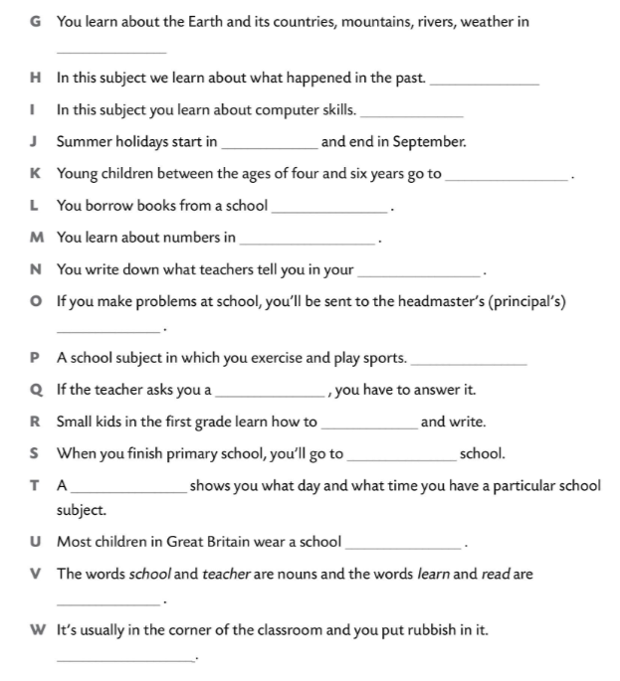
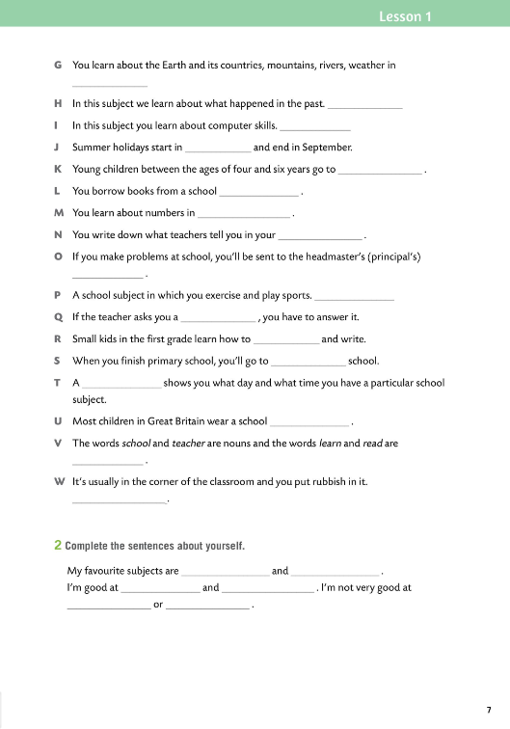
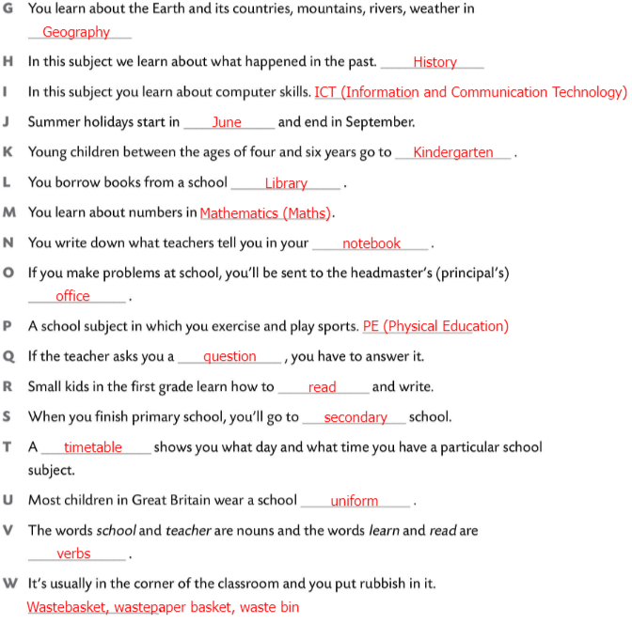
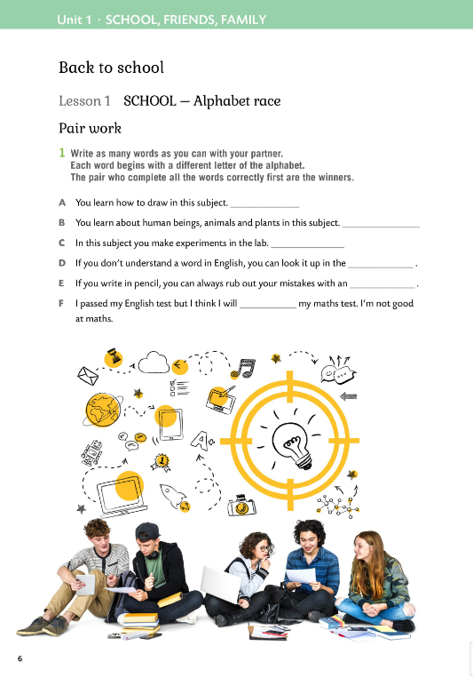

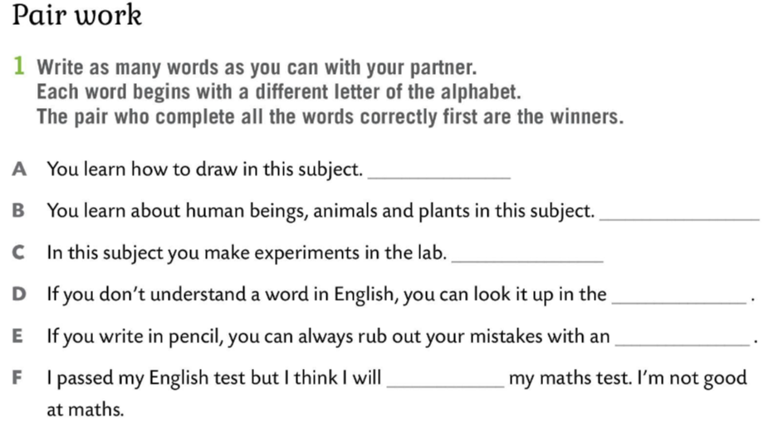
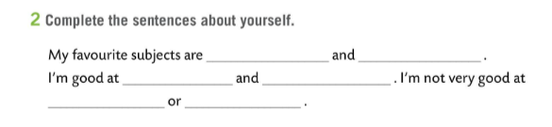
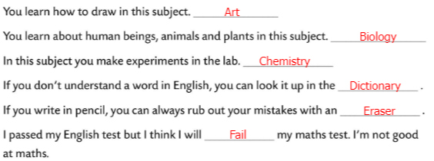
Workbook, pages 6 & 7
Work in pairs.
Write as many words as you can. Each word begins with a different letter of the alphabet. The pair that first completes all the words correctly, is the winner.
Check.
Complete the sentences about yourself.

Slide 6
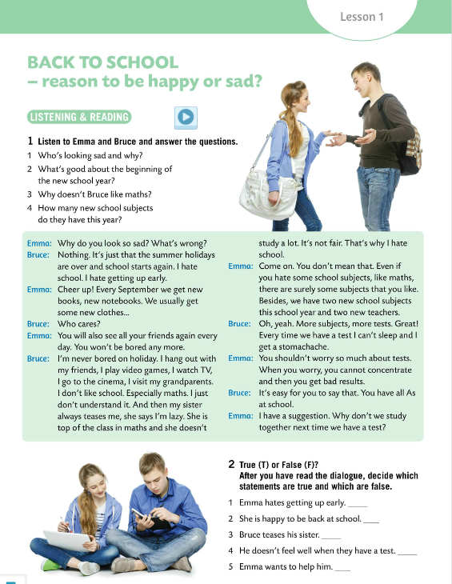

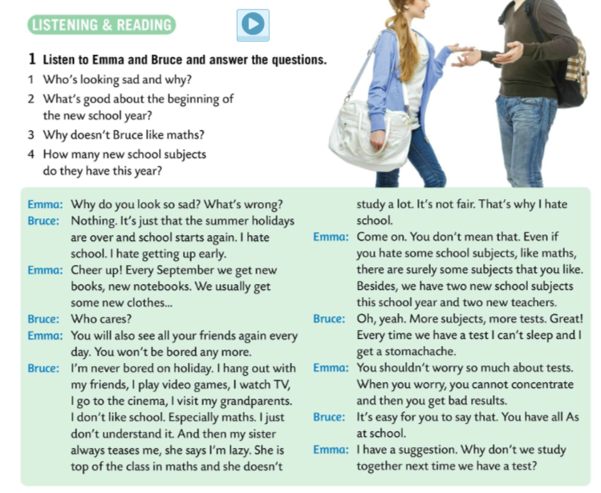
Listen to Emma and Bruce. Are you happy to be back to school? Do you look forward to another school year?
Read the text and underline the new words.
Translate them with the help of the dictionary.
Check.
1 Bruce is sad because summer holidays are over and school starts again.
2 Pupils get new books, new clothes. They see their friends again.
3 He doesn't understand it.
4 They have two new school subjects this year.
Listen to Emma and Bruce talk once again and answer the questions.
Read the text in pairs.

Slide 7
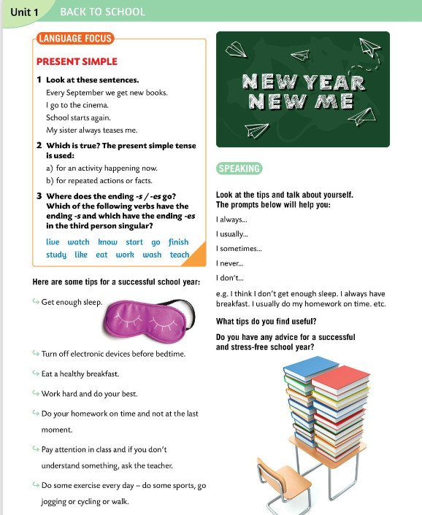
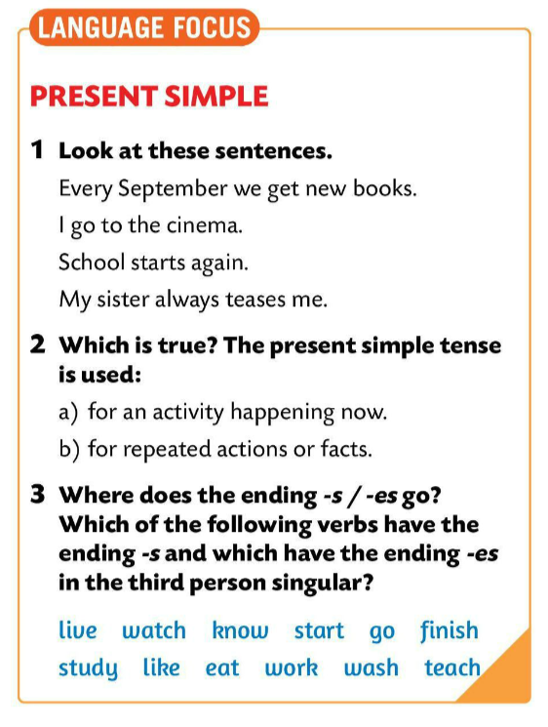
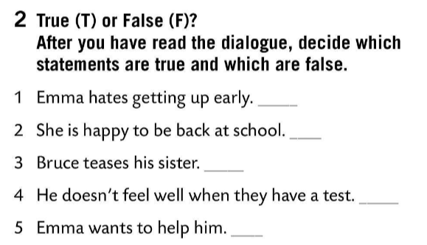
True (T) or False (F)?
Decide which statements from the dialogue are true and which are false.
LANGUAGE FOCUS
Which one is true? Circle.
Check.
F
T
F
Present simple is used for repeated actions or facts.
Glagolsko vrijeme present simple koristimo za radnje koje se ponavljaju i za činjenice, tj. za radnje koje su trajno istinite.
T
T

Slide 8
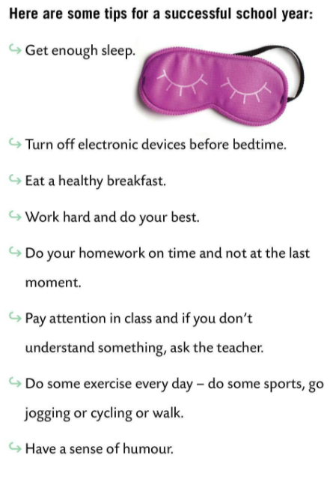
Which of the following verbs have the ending –s and which have the ending –es in the third person singular?
Check.
Lives, watches, knows, starts, goes, finishes, studies, likes, eats, works, washes, teaches.
Which tips do you find useful? Why?

Slide 9
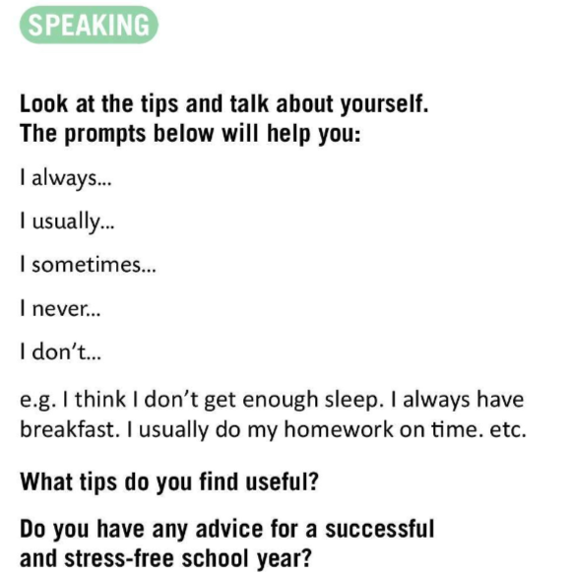

Look at the tips and talk about yourself. The prompts will help you.
Do you have any advice for a successful and stress-free school year?
Work in pairs and add 4 new tips to the list.

Slide 10
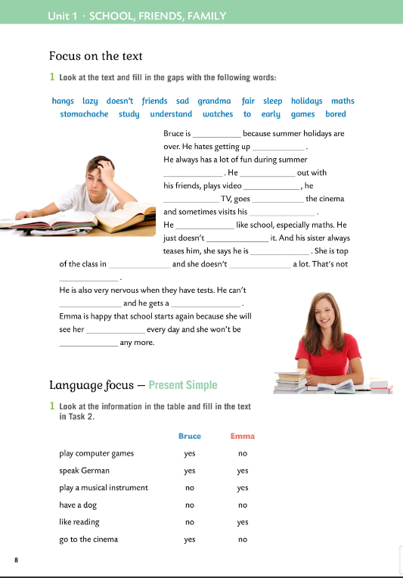
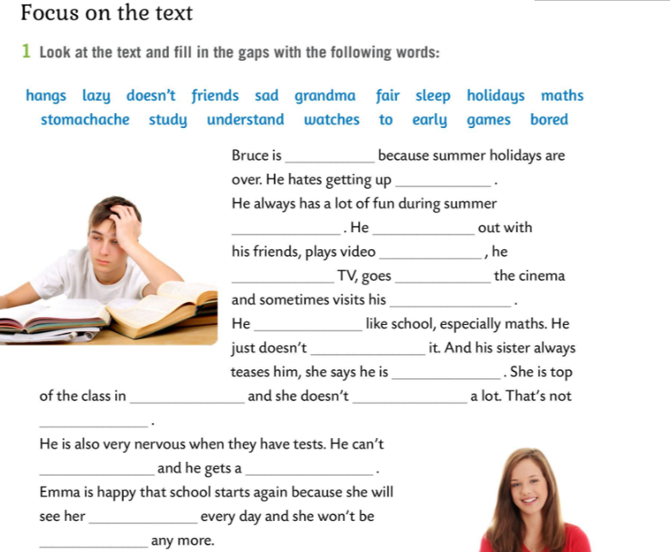
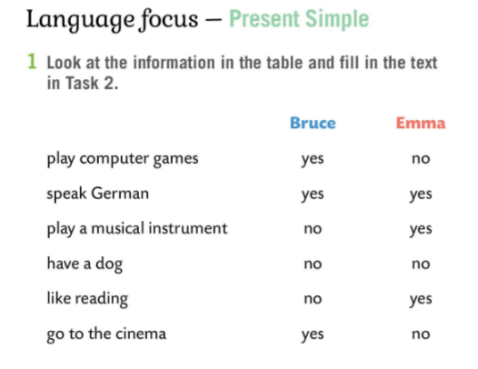
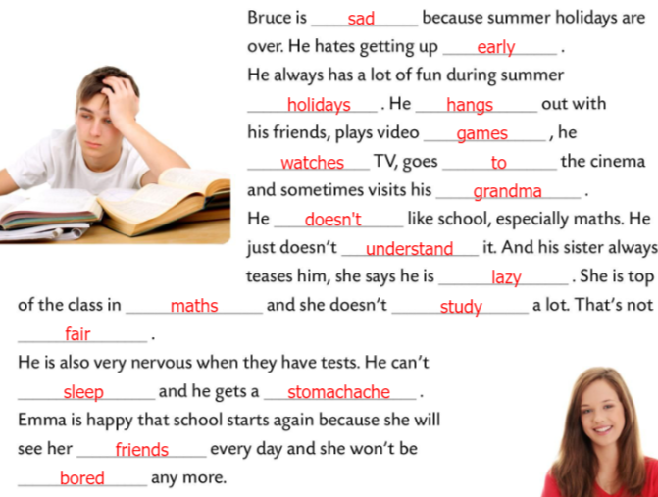
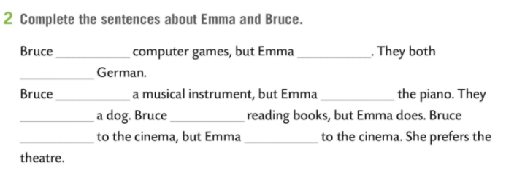
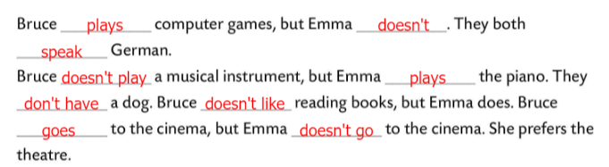
Workbook, pages 8 & 9
Look at the text and fill in the gaps with the words below.
Check.
Look at the infomation in the table and fill in the text in Task 2.
Check.

Slide 11
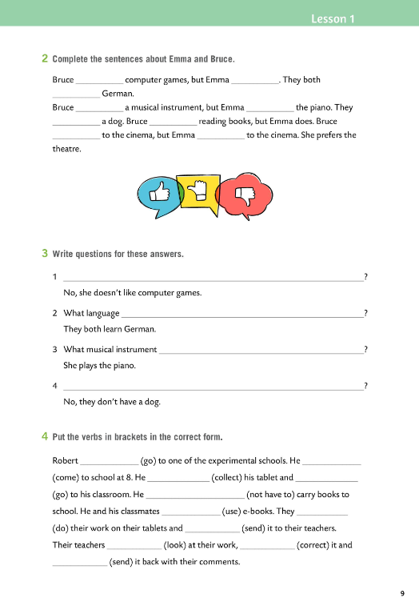
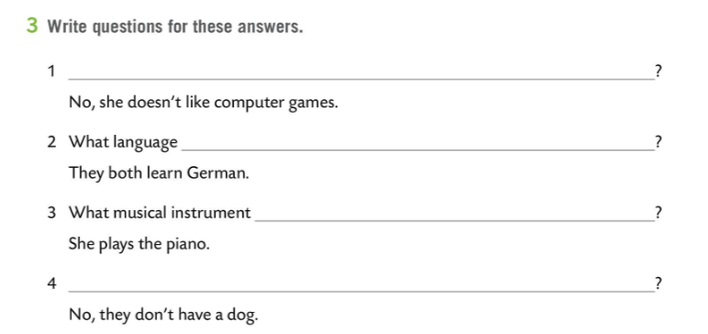
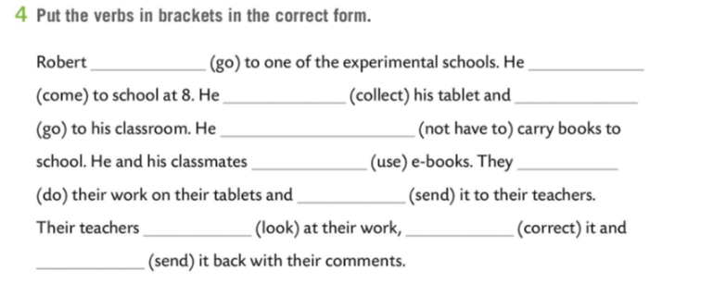
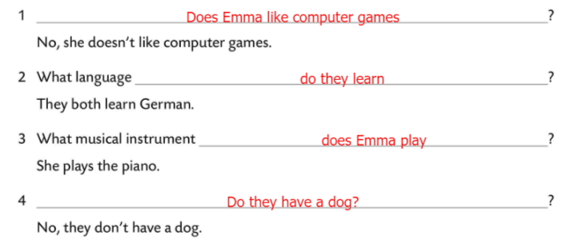
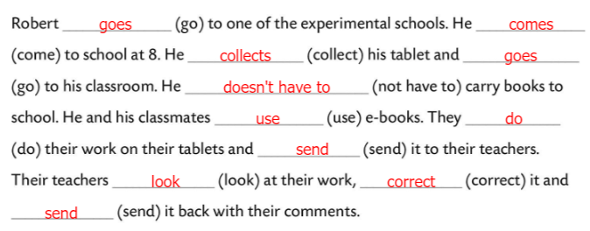
Workbook, page 9
Write questions for these answers.
Check.
Put the verbs in brackets in the correct form.
Check.

Slide 12
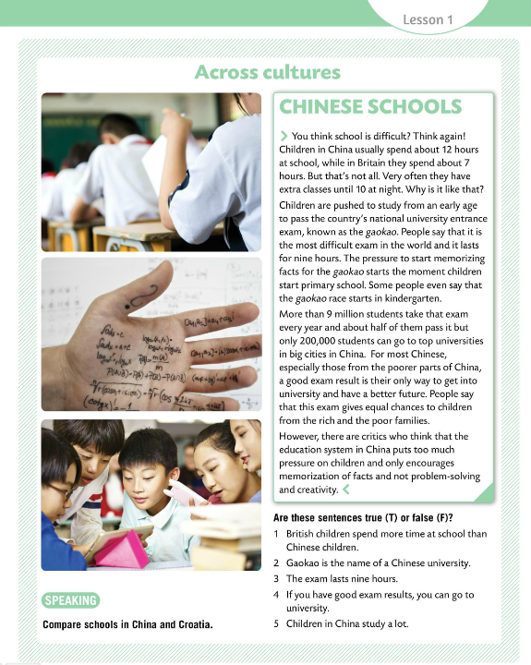
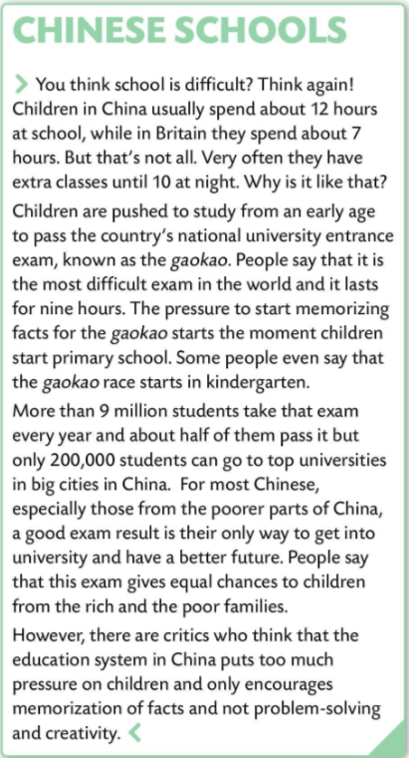
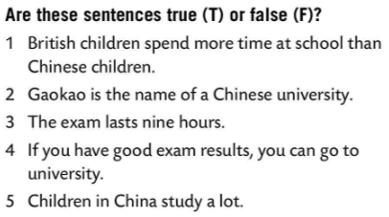
Read the text and compare schools in China and Croatia.
Read the text again and decide whether the sentences are True (T) or False (F).
F
F
Check.
T
T
Play a game! Choose the correct form of the verb.
https://learningapps.org/watch?v=pye5t3cr520
T

Slide 13
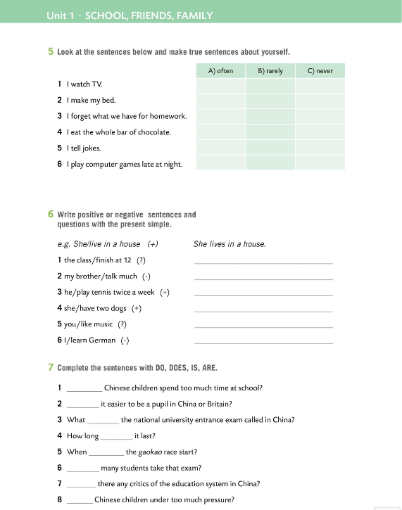
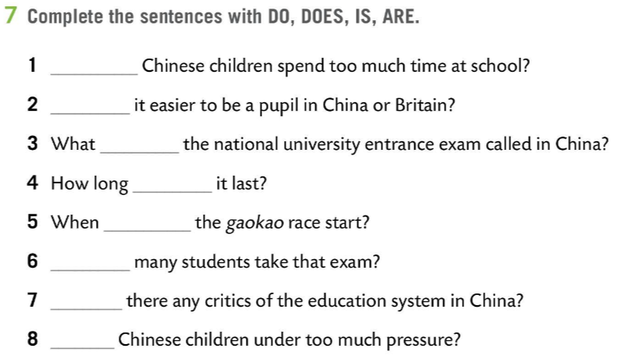
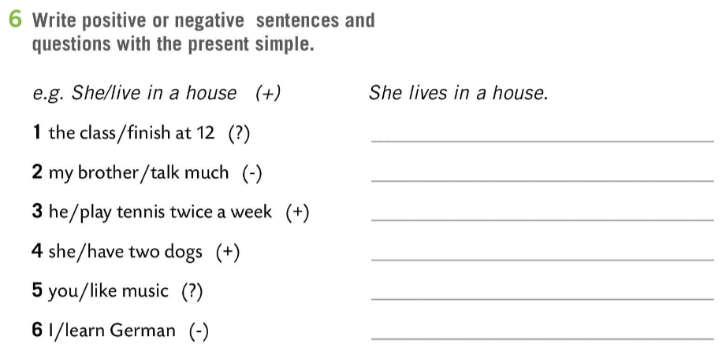
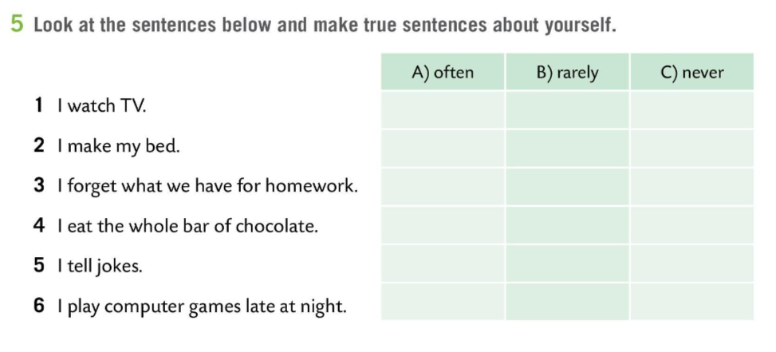
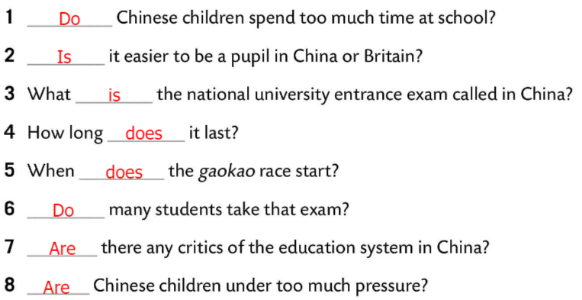
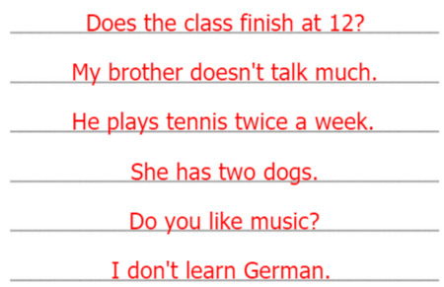
Workbook, page 10
Make true sentences about yourself.
Write positive or negative sentences and questions with the present simple.
Check.
Complete the sentences with DO, DOES, IS, ARE.
Check.

Slide 14
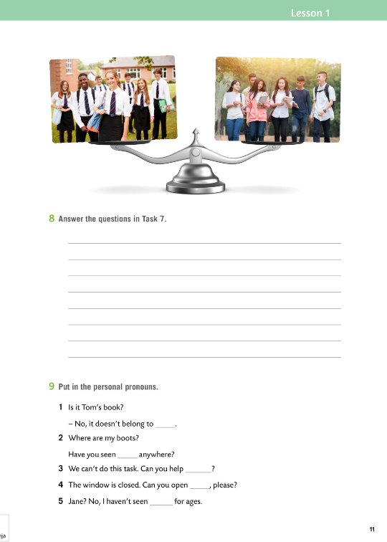
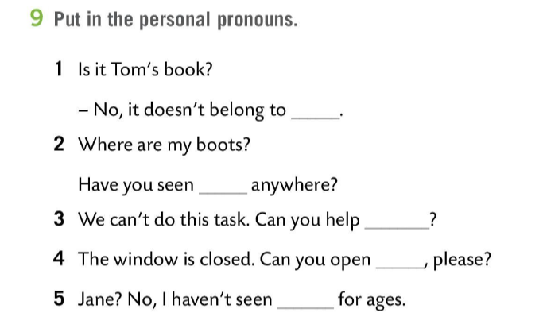
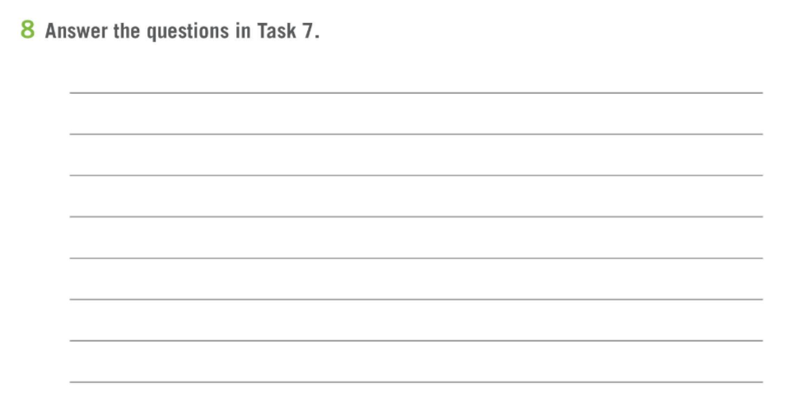
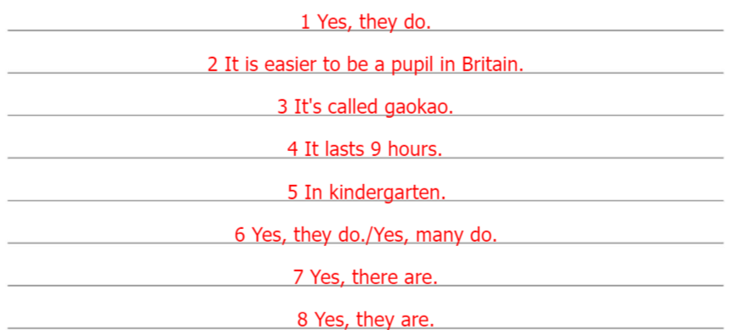
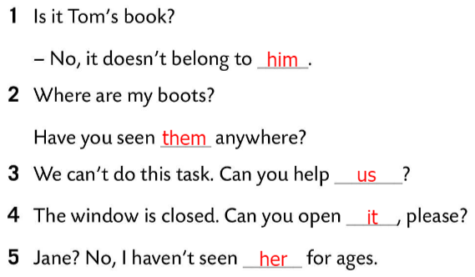
Workbook, page 11
Answer the questions in Task 7.
Check (Possible answers).
Put in the personal pronouns.
Check.

